Slide 1
Space and Time
October 29, 2019

Slide 2
What drives changes in ecosystem processes over space and time?

Slide 3
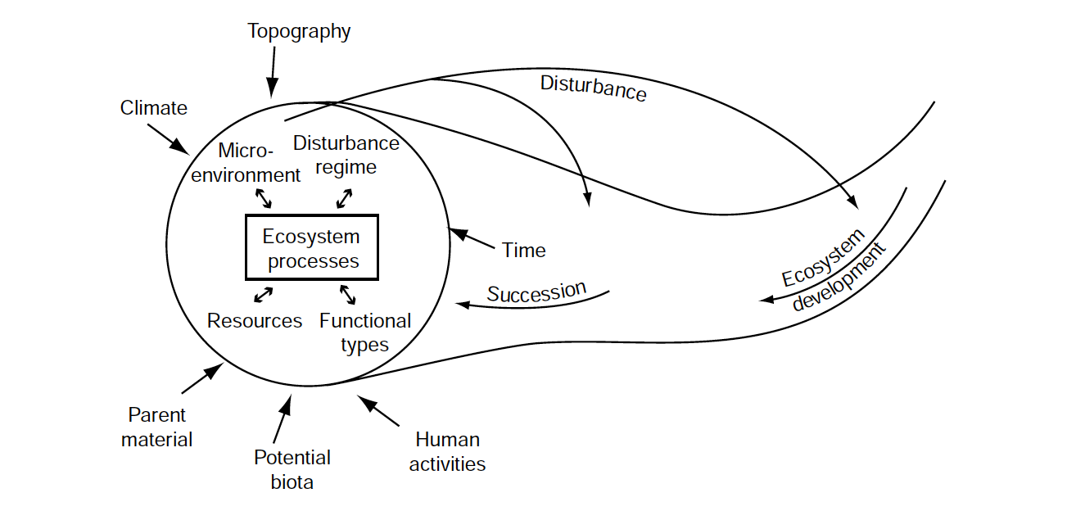
In your book, but modified from Chapin et al. (2006)

Slide 4
Resilience

Slide 5
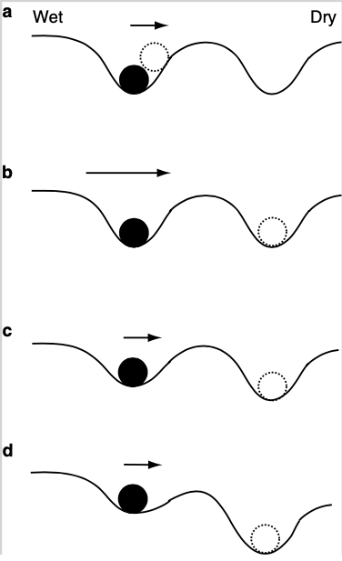
Depth of cup defines resilience of ecosystem
Length of arrow defines the strength of disturbance

Slide 6
Resilient, weak disturbance
Resilient, strong disturbance
Not resilient, weak disturbance

Slide 7
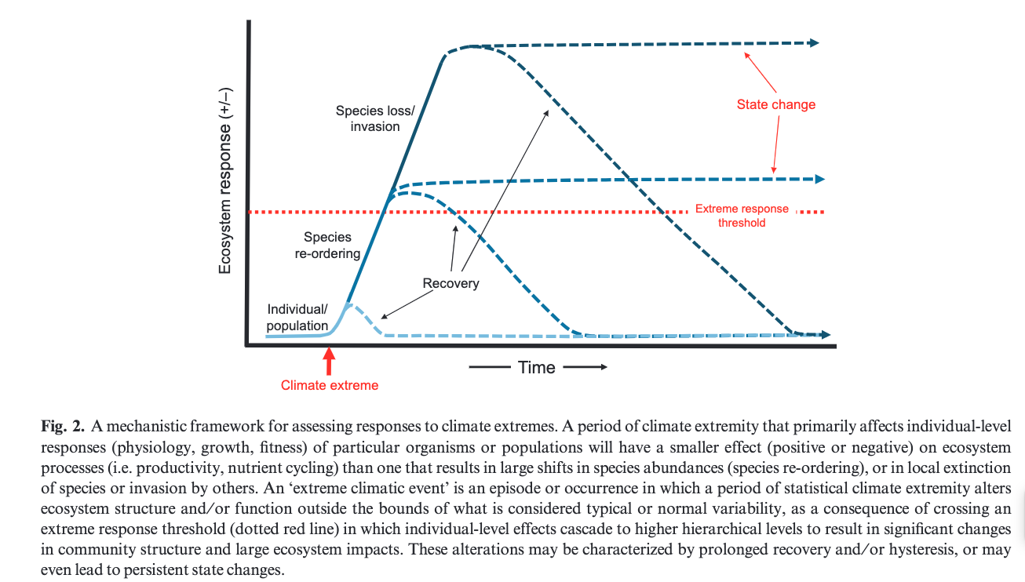
MD Smith (2011) J Ecology

Slide 8
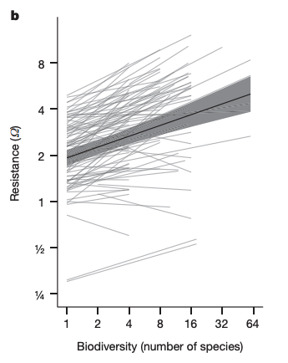
Isbell et al. (2015) Nature

Slide 9
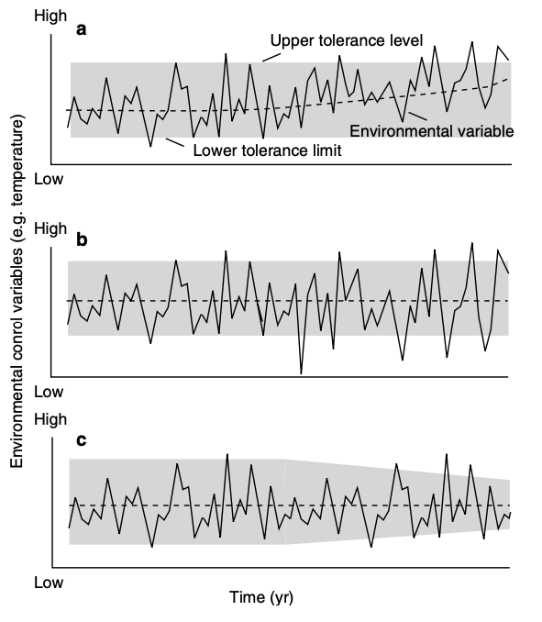
Range of resilience defines response
Directional shift in env. = more time outside range
More variable env. = more time outside range
Change in range = more time outside range

Slide 10
History

Slide 11
It is important to understand the natural trajectory of a system to fully understand impact of a change

Slide 12
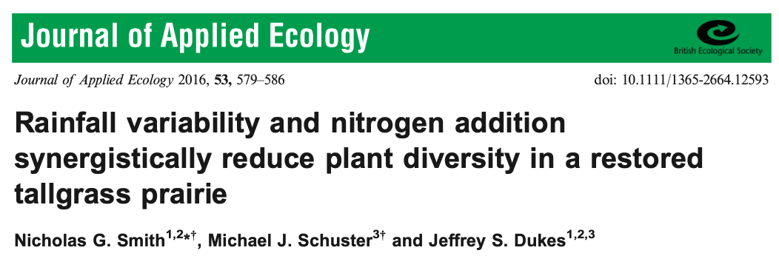
It is important to understand the natural trajectory of a system to fully understand impact of a change

Slide 13
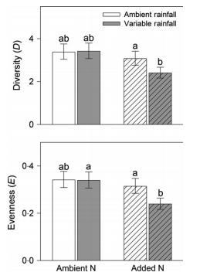
Smith et al. (2016) J Applied Ecology

Slide 14
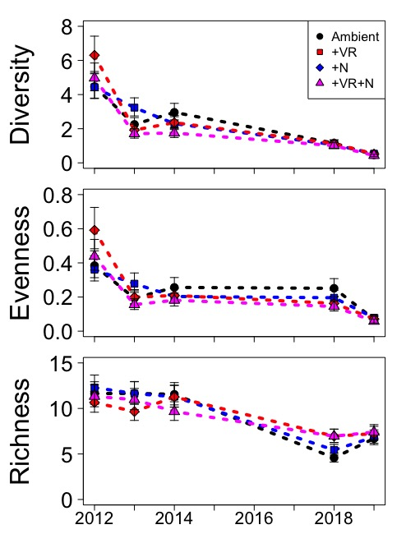
Treatments initially decreased diversity, but whole system was headed in that direction
Ploughe et al. (in review)

Slide 15
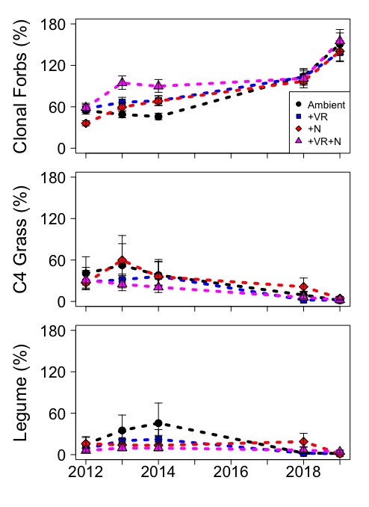
Treatments initially decreased diversity, but whole system was headed in that direction
Ploughe et al. (in review)

Slide 16
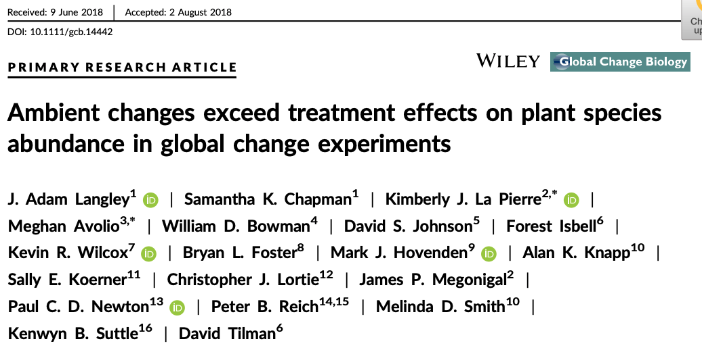

Slide 17
Disturbance

Slide 18
Is disturbance bad for ecosystems?

Slide 19
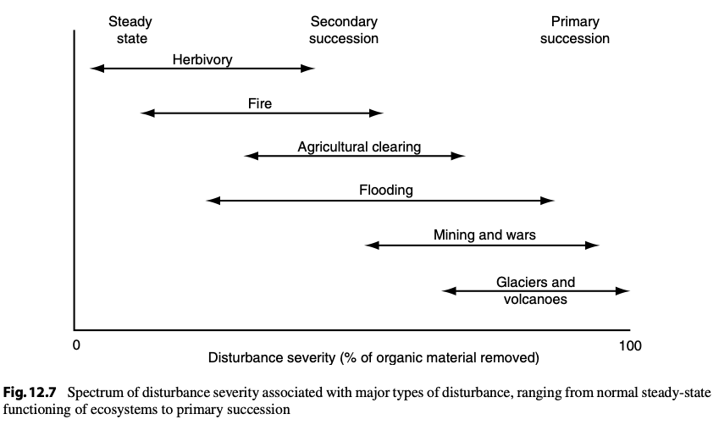

Slide 20
Types of succession
Primary
All organic matter is removed
Very little starting material
E.g., volcano, glacier
Secondary
Some organic matter remains
Some starting material
Happening all the time
E.g., fire, herbivory

Slide 21
An ecosystem’s disturbance regime
Type of disturbance
What happens?
Severity of disturbance
How much change does it cause?
Frequency of disturbance
How often does it happen?

Slide 22
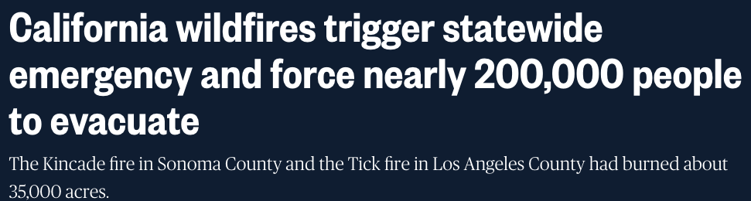
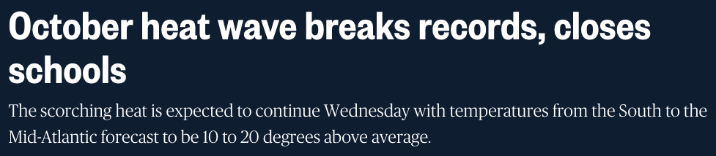
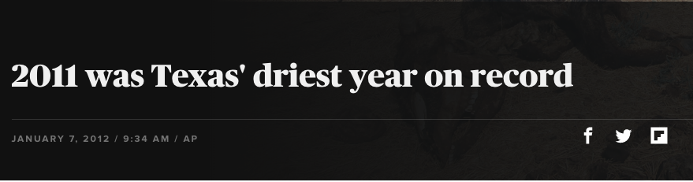
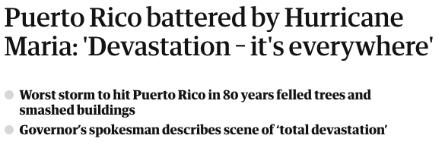
Global change is impacting disturbance regimes
NBC (10/02/19)
NBC (10/27/19)
AP/CBS
Guardian (09/21/17)

Slide 23
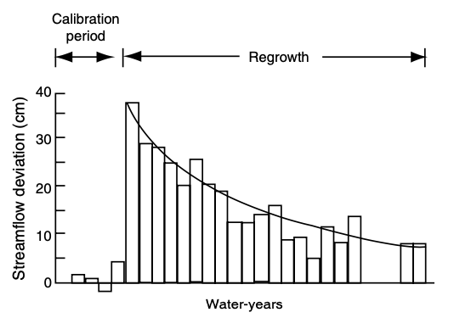
Ecosystem impacts of disturbance - water

Slide 24
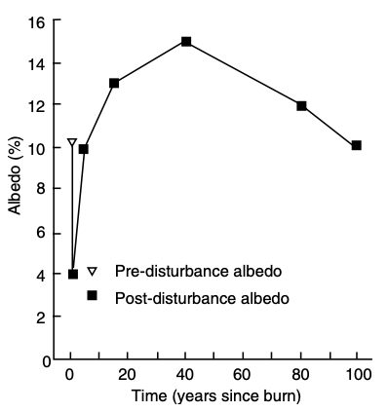
Ecosystem impacts of disturbance - energy

Slide 25
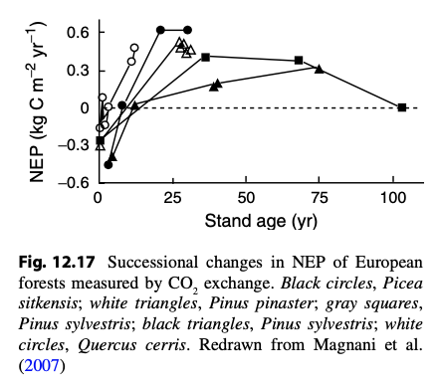
Ecosystem impacts of disturbance - carbon

Slide 26
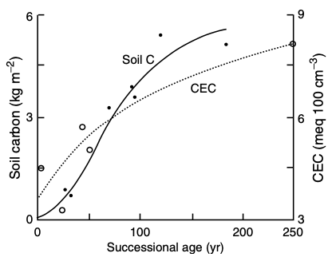
Ecosystem impacts of disturbance - soil

Slide 27
Ecosystem impacts of disturbance - herbivory

Slide 28
Ecosystem impacts of disturbance - herbivory
Herbivory is highest during mid succession
Plant biomass is high
Plants investing in growth, not defense
Herbivores can enhance succession
Might not be good for them!
Herbivores
Early successional plants
Late successional plants
Modified from Paster et al. (1988) BioScience

Slide 29
Why is it important to consider the time scale of a study?

Slide 30
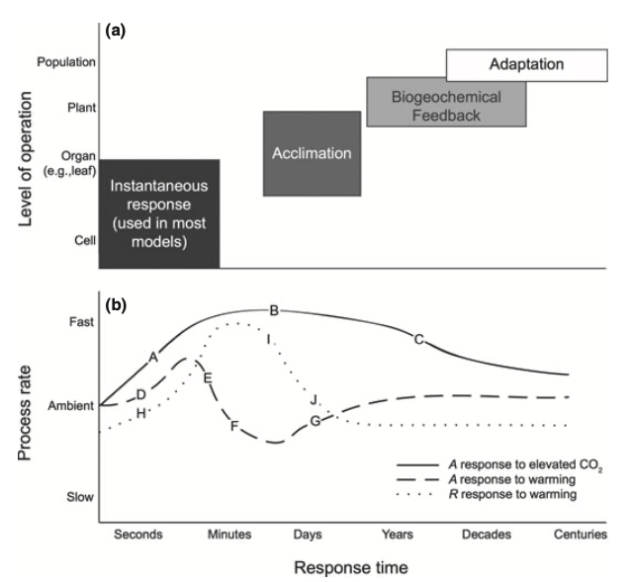
Smith and Dukes (2013)

Slide 31
Land use and land cover change (LULCC)

Slide 32
Land use and land cover change
Change from one land type to another
Largest ongoing global change

Slide 33
Eco-climatic teleconnections

Slide 34
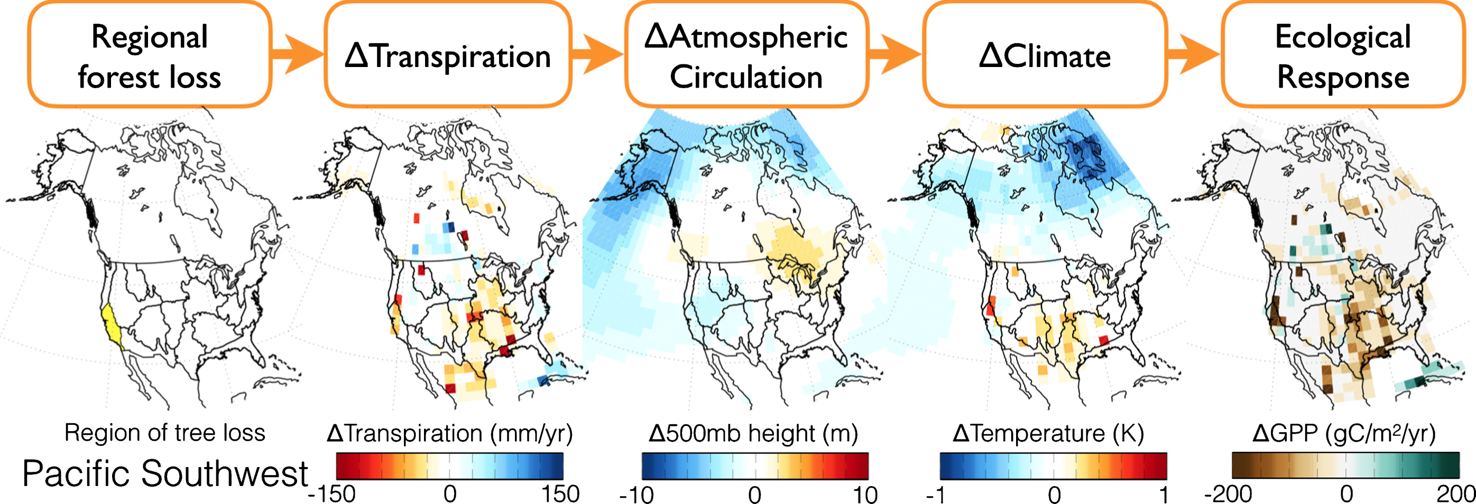
Swann et al. (2018) Env. Res. Let.

Slide 35
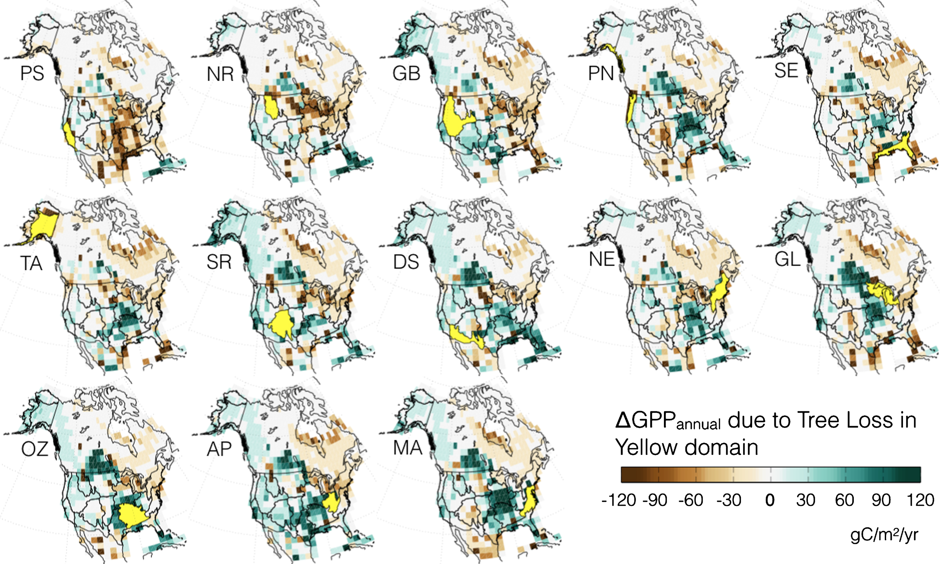
Swann et al. (2018) Env. Res. Let.

Slide 36
How do we predict spatio-temporal changes in ecosystem processes?

